Slide 1
ANDROID – PART 3
CONSTRAINTLAYOUT, COORDINATOR LAYOUT

Slide 2
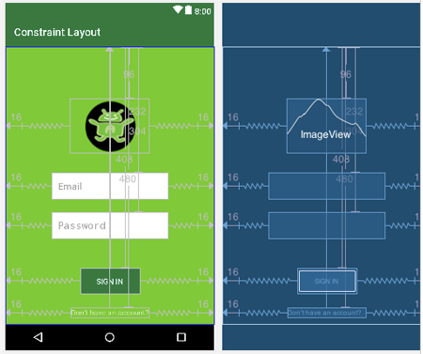
ConstraintLayout

Slide 3
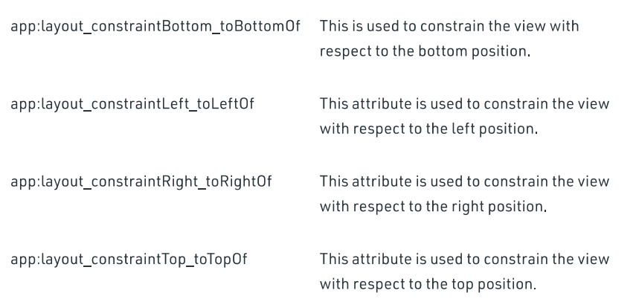
ConstraintLayout

Slide 4
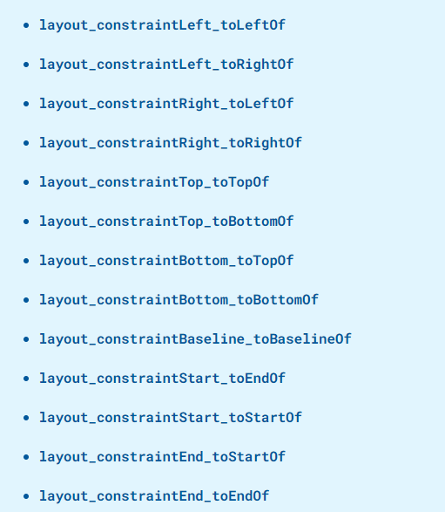
ConstraintLayout

Slide 5
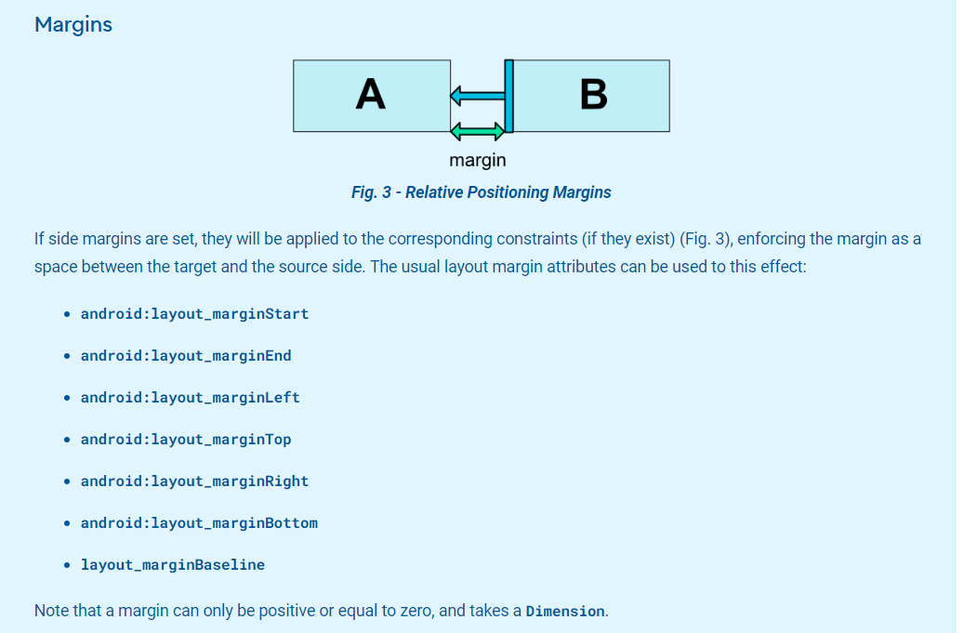
ConstraintLayout

Slide 6
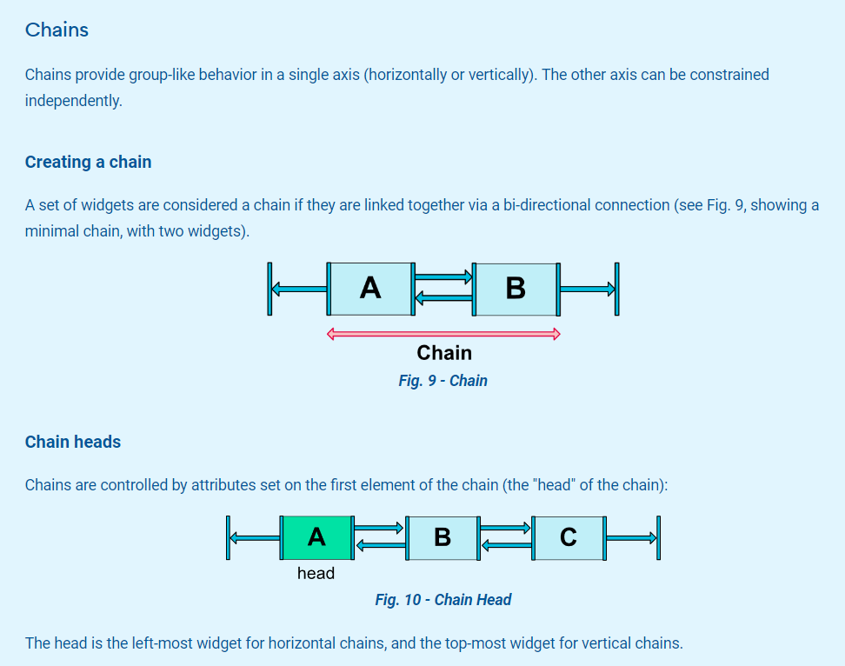
ConstraintLayout

Slide 7
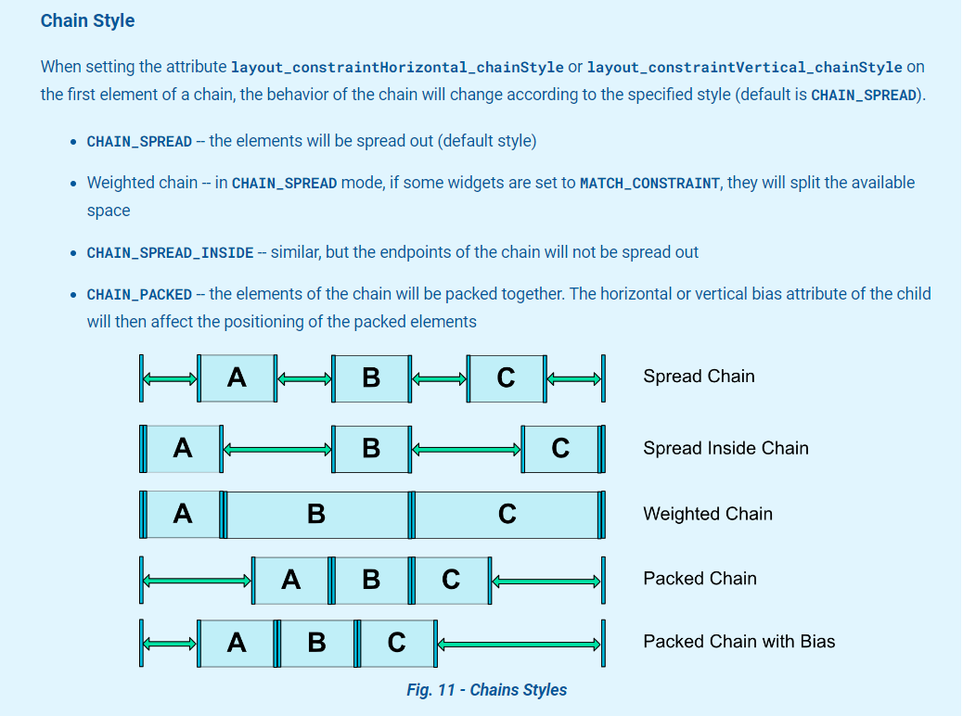
ConstraintLayout

Slide 8
CoordinatorLayout
https://guides.codepath.com/android/handling-scrolls-with-coordinatorlayout

